Slide 1
Dumbstruck Gold
Tristan Canova, Hamza Memon,
Emmanuel Rosario, Grant Boughton, Wyatt Sawyer

Slide 2
Project Vision
What does Dumbstruck do?
Live video analytics
Crowd analytics
User facing dashboard for data display

Slide 3
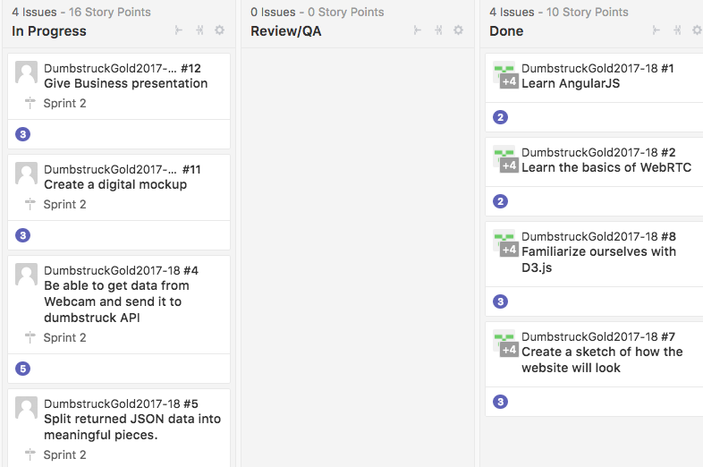

Slide 4

WebRTC
Web Real Time Communication
Before WebRTC
How we will use it

Slide 5
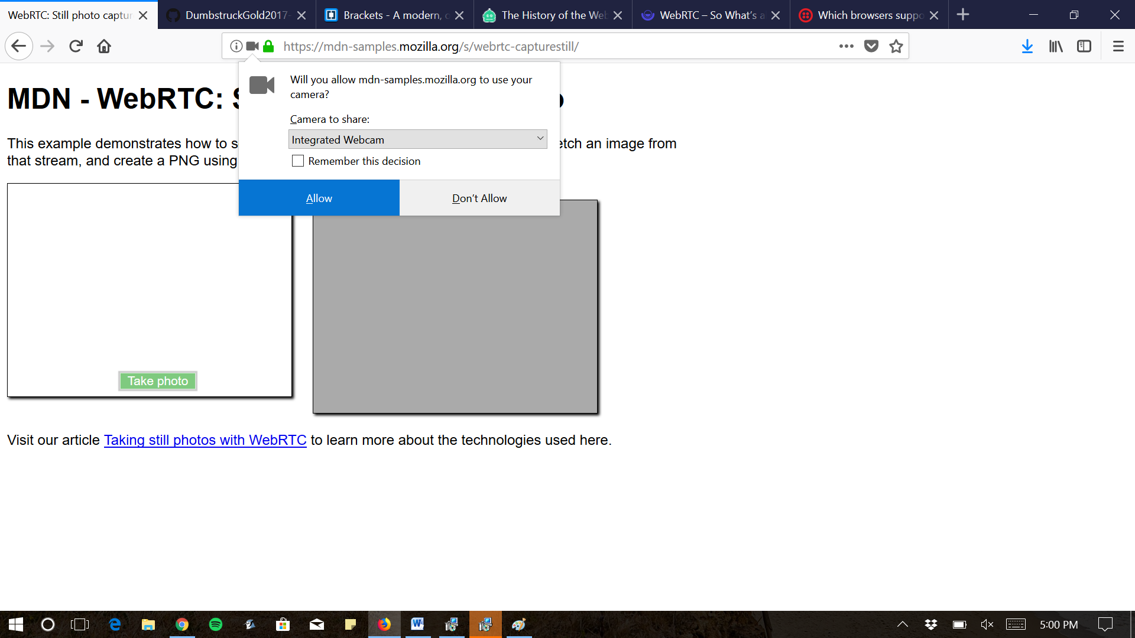

Slide 6
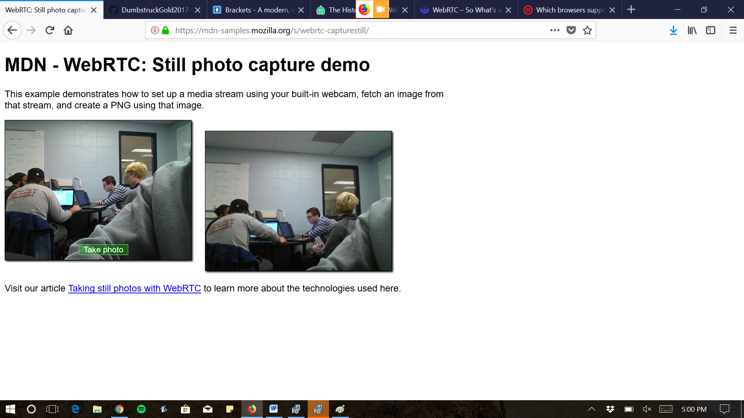

Slide 7
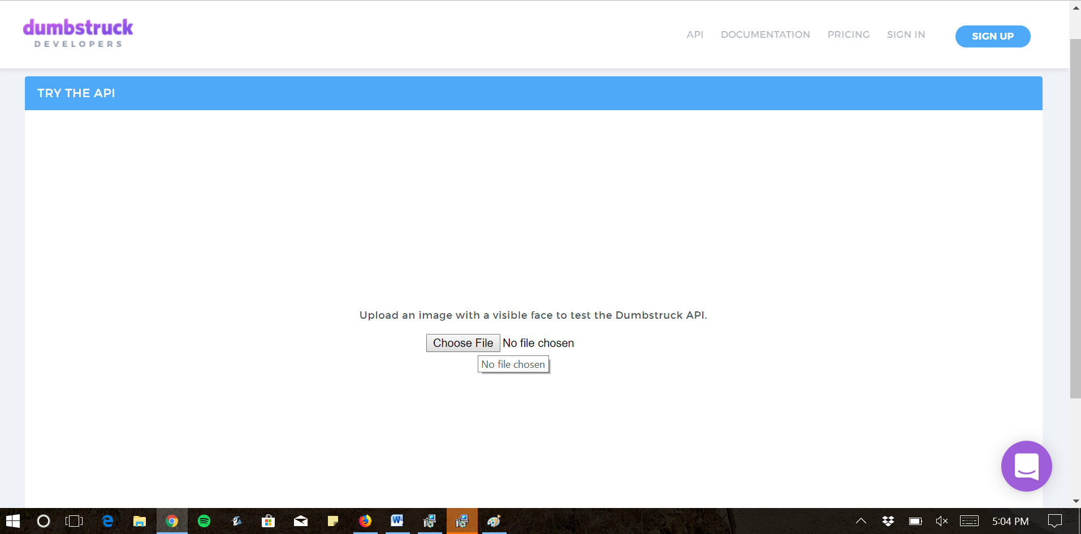

Slide 8
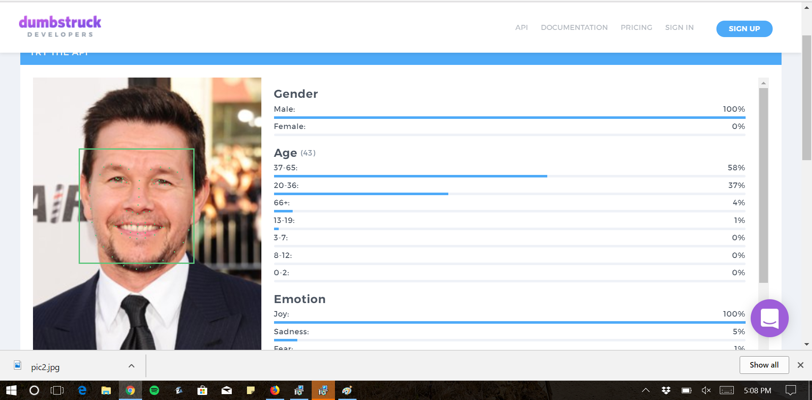

Slide 9

Data-Driven Documents (D3)
Visualize data
Provides effective tools to manipulate documents based on data
Notes:
Hamza, please remove last link and send to cotler

Slide 10
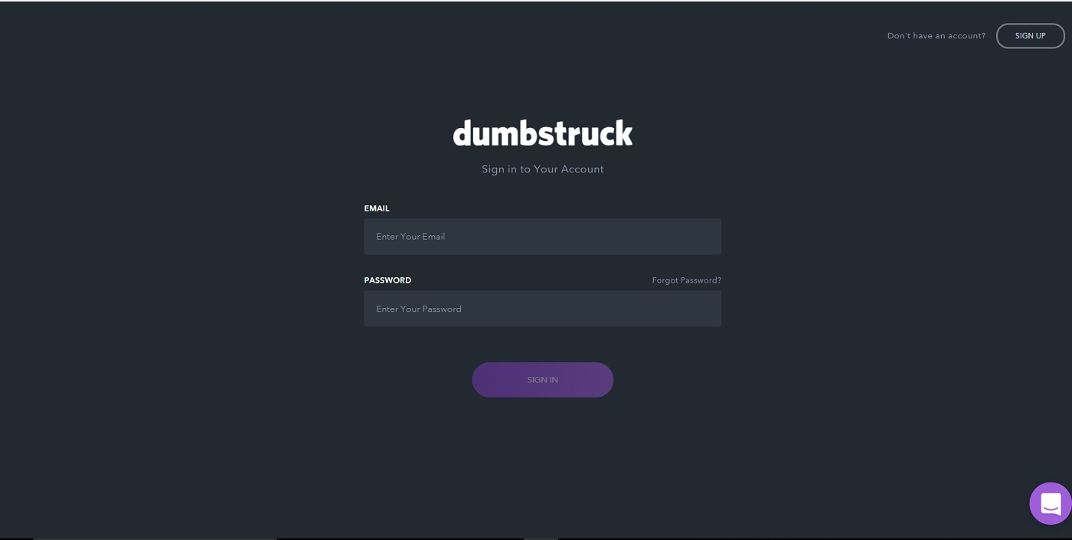
PRESENTATION MATERIAL ASSIGNMENTS

Slide 11
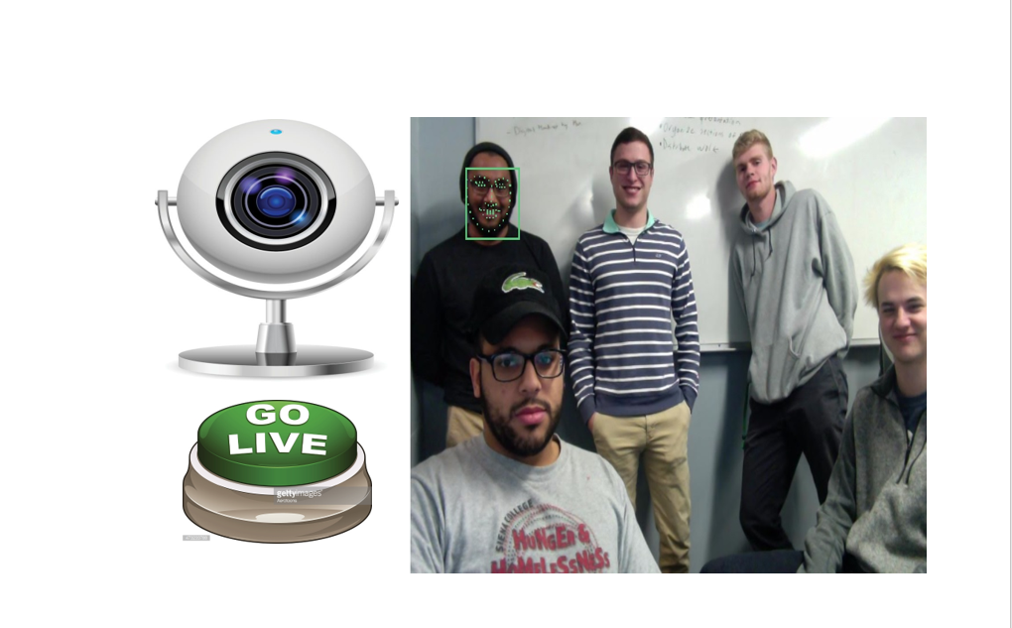

Slide 12
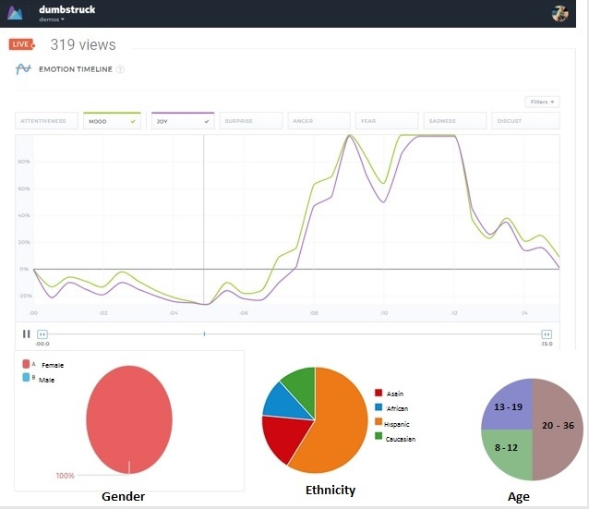

Slide 13
Lessons Learned

Slide 14
Thank You
Special Thanks to our clients!

Slide 15
Questions ???

